Slide 1
An Analysis of Corvid-19 Springboard Unit 20.3 Story Telling
Jiaqi Xu
Sep 2, 2020

Slide 2

Background of Coronavirus Disease 2019 (COVID‑19)
Caused by severe acute respiratory syndrome coronavirus 2
First identified in December 2019 in Wuhan, Hubei, China
As of 31 August 2020, more than 25.3 million cases have been reported all over the world and more than 848,000 deaths
Common symptoms include fever, cough, fatigue, shortness of breath or breathing difficulties, and loss of smell and taste
Source: https://www.newscientist.com/term/covid-19/

Slide 3
Dataset and Analysis
Dataset
2019 Novel Coronavirus COVID-19 (2019-nCoV) Data Repository by Johns Hopkins CSSE. https://github.com/CSSEGISandData/COVID-19
Analysis
Jupyter Notebook from Tarun Kumar. https://github.com/tarunk04/COVID-19-CaseStudy-and-Predictions
Data used up to Aug 24,2020

Slide 4
China Vs Outside China First 60 days

Slide 5
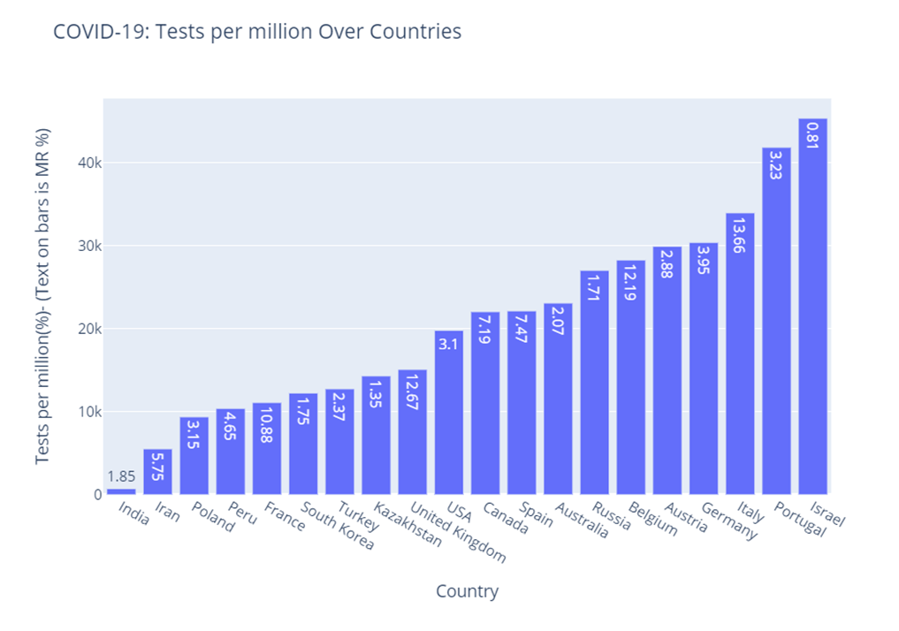
Graphical Analysis of Testing Data

Slide 6
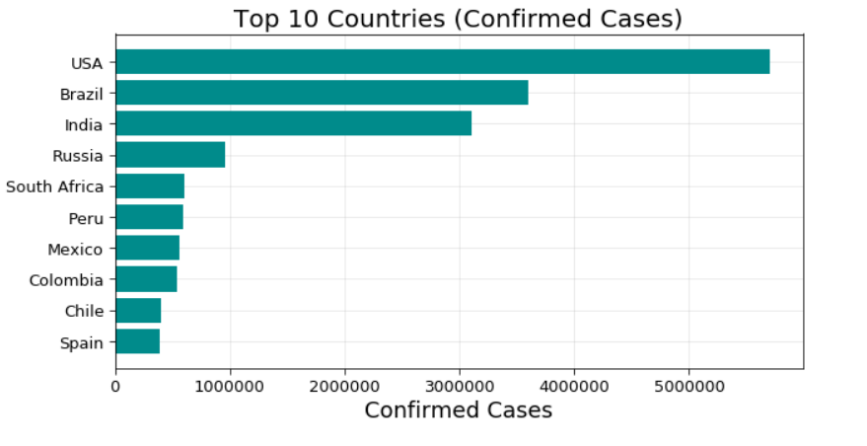
Confirmed, Deaths, Active and Recovered

Slide 7
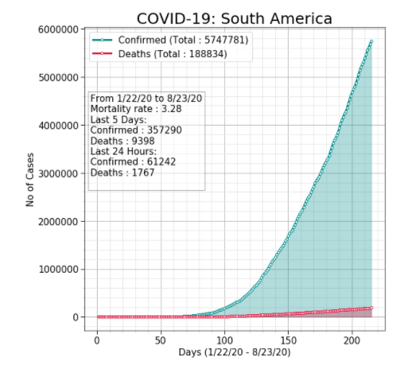
Spread Trends in the World and Continents

Slide 8
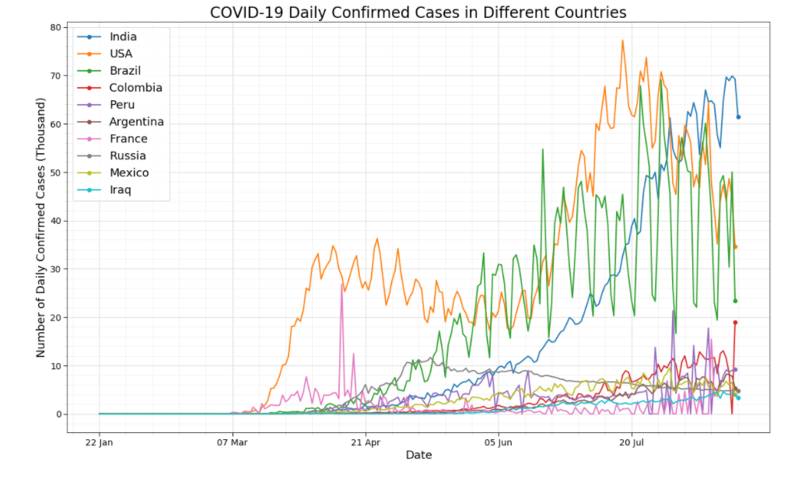
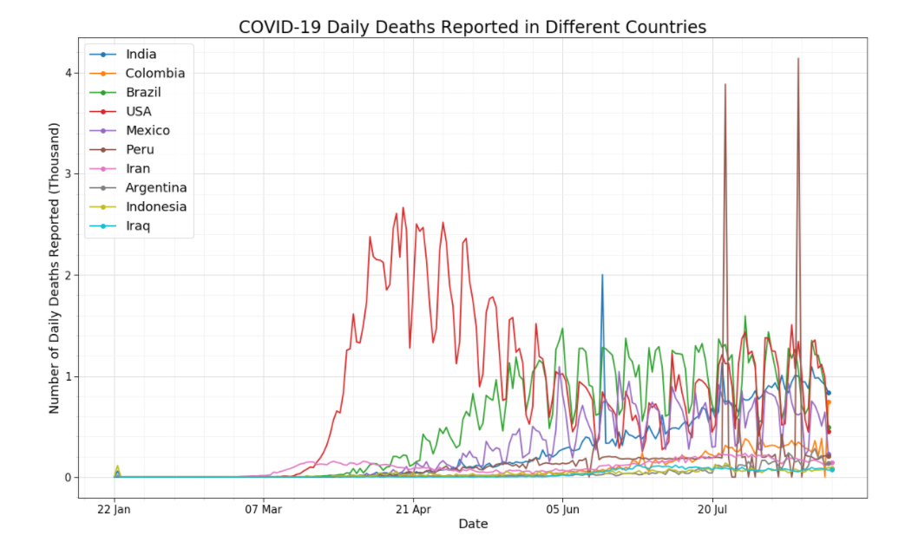
Daily Cases in Different Countries

Slide 9
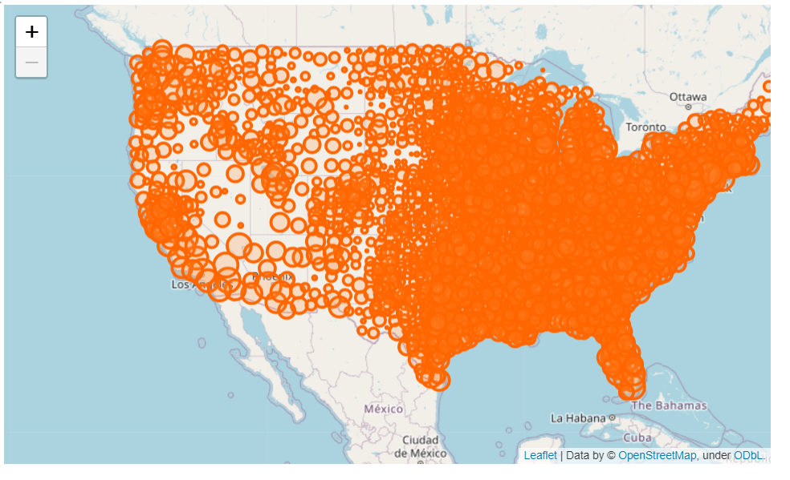
USA: Most Affected States

Slide 10
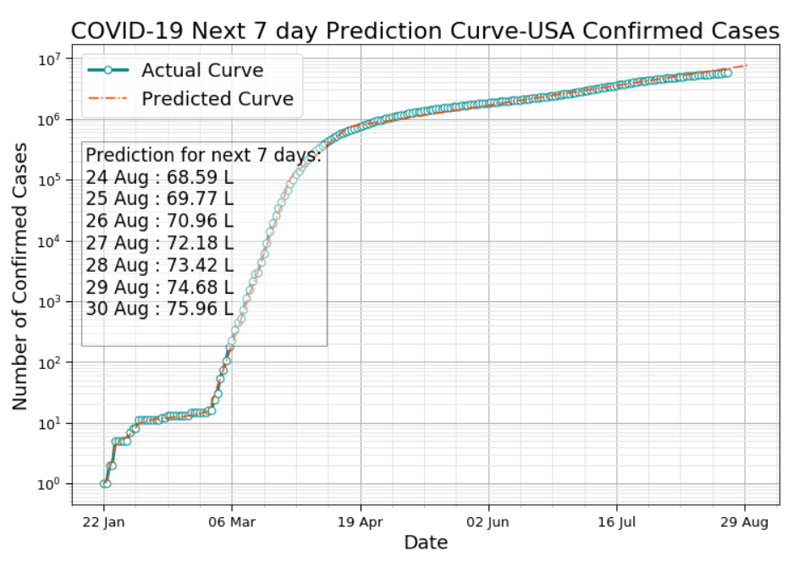
Prediction of Next 7 Days

